Slide 1

ConnectME.. Recruitment bridge portal
Team : DRIFTERS
Paramdeep Saini
Julian Simon
Sandhya Gadgoli
Viswanath Kambam
1

Slide 2

OUR BIG IDEA
Implement smart solution to ease hiring process there by bringing out best talent and streamline the hiring process

Slide 3



Need for a smart evaluating approach
Recruitment Management tool is important to have a state of art recruitment system that assists the companies in initial screening of the candidates based on the profiles provided by the different companies.
ConnectME tool will evaluate the candidates based on their skills. The scanning of profiles will be done based on the inputs/questionnaires provided by the company.
Recruiter can login and create questions and review the feedback
Performance of each individual candidate will be recorded and shared the same with the company and Candidates.
The candidate can access the test and can also see the time remaining to attempt the question.
It is a complete SaaS solution on AWS.
Our tool will adhere to all company policies and rules, while interviewing the candidates.

Slide 4
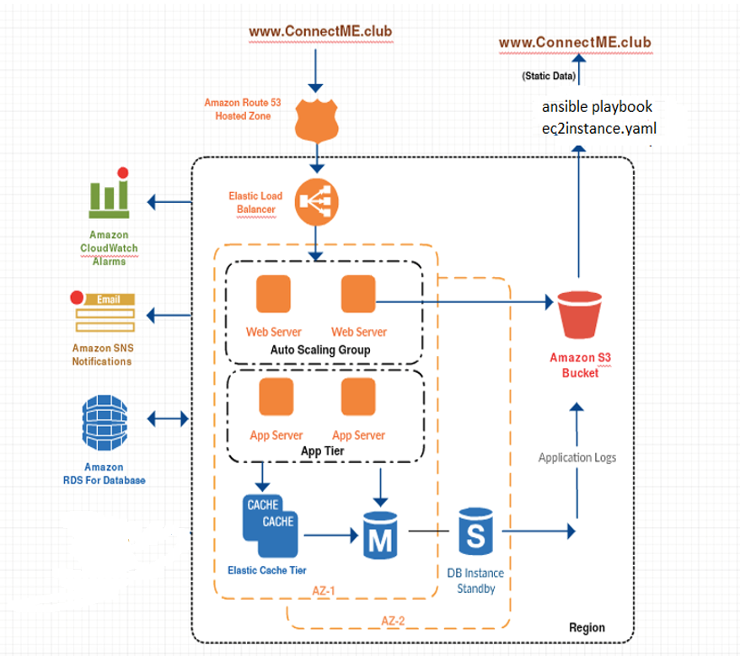
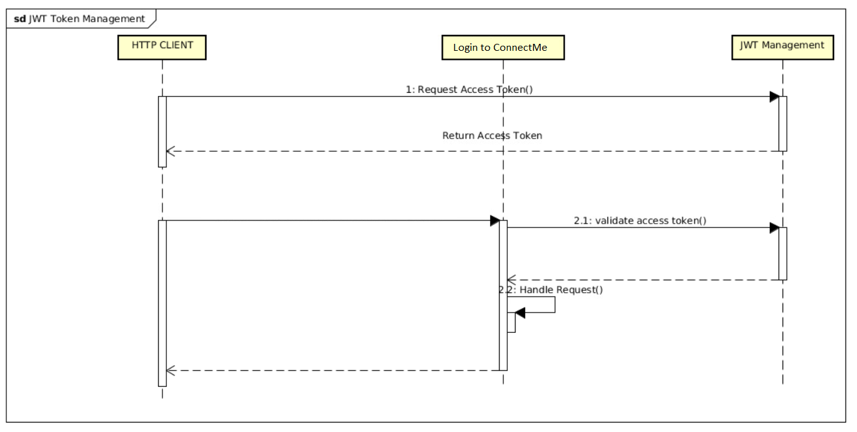
Architecture Diagram:
Architecture Diagram

Slide 5
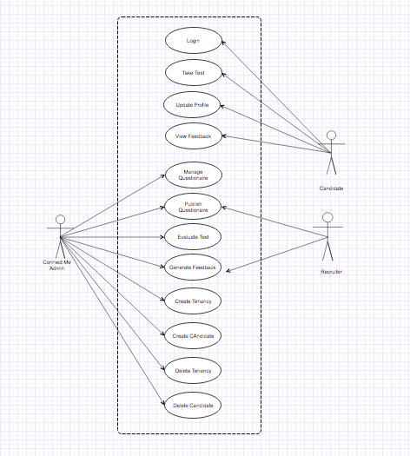
Architecture Diagram:
Use Case Diagram

Slide 6
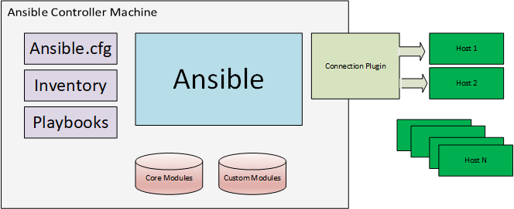
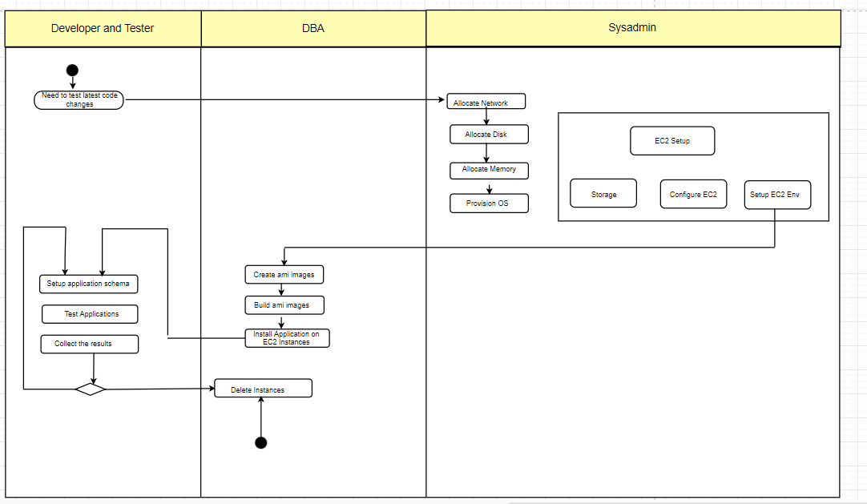
Architecture Diagram:
Deployment Diagram:

Slide 7
Features List and Roles
ConnectMe Admin
Manages Entire Portal and has Super admin access
Add and Delete Tenancy
Add and Delete Candidates
Create and Publish Questionnaire
Evaluate Tests
View and Publish results
Applicants register under our portal which enables them to take the test. A new user record is created in RDS. If an already existing user tries to sign up, he is displayed alert message “Already Registered”.
Username and password are validated, and Authorized users can only successfully login which will be indicated by alert message.
We have role-based login which controls the access to different pages.
Myproject Page acts as main activity area and Different users can perform the activities described above as per their respective roles.
Recruiter
Manage Questionnaire
Publish the results
Candidate
Login
Update Profile
Take test
View results

Slide 8
Technologies Used
Pyhton 2.7 +,
Nginx Container (reverse proxy)
HTML5, CSS,Ajax, Bootstrap, Java Script
Flask, and Jwt
RDS MySQL
Ansible Playbooks for Infrastructure Provisioning

Slide 9
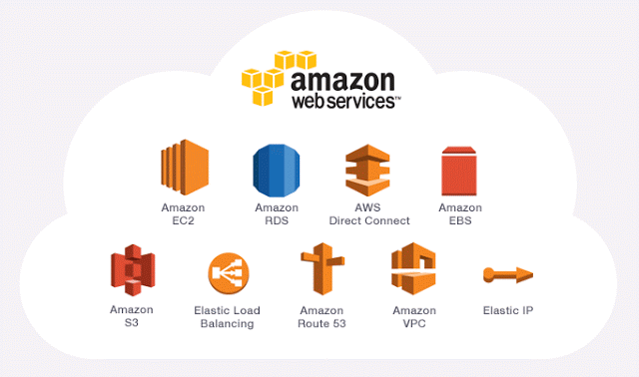
Amazon Cloud Services used:
EC2: Compute instance for python application.
Amazon Polly used for reading the page contents like in MyProjects and Quiz.
Elastic Beanstalk: For deploying the application
Ansible provision Infrastructure using AWS as Ansible is simple fastest and lightweight.
Autoscaling Group: Auto-scaling group provisioned to scale up EC2 during peak demand or higher availability and scalability.
CloudWatch: To set up monitoring on the Autoscaling group instances.
IAM: To manage access to AWS services and resources securely.
SNS: Notification any failure in autoscaling group detected by CloudWatch.
CloudTrail: To view recent events and log AWS API calls
Amazon Machine Learning with RDS is used to display predictive test performance pattern by the candidates on the question set.
9

Slide 10

DEMO
https://theconnectme.club/

Slide 12
THANK
YOU
12

